Slide 1
U.C. Berkeley: Economics 115: Spring 2020
20th Century Economic History: Lecture 16: Inclusion
Brad DeLong
Department of Economics & Blum Center, U.C. Berkeley; & WCEG
delong@econ.berkeley.edu
last revised: 2020-03-24
for delivery: 2020-04-15
<https://bcourses.berkeley.edu/courses/1487684>
<https://github.com/braddelong/public-files/blob/master/econ-115-lecture-16.pptx>

Slide 2

Inclusion: Ethnicity & Gender
Inequality & domination as standard procedure for humanity:
A great deal of inequality in human societies is economic inequality: work, income, spending, and prices.
A great deal is simply things that;
you are not allowed to do, o
r are expected and required to do,
by virtue of what we might as well call your status-group, your estate, your caste.
Minorities. Serfs. Slaves. Women.
A great deal of this fueled by status inequality that is immutable (or nearly immutable) based on your individual characteristics
You had social power only if you were male
Even if you were male, only if you were the right tribe, caste, lineage, & c.
That was how it was
That was how people expected it would always be
Unless and until humans obtained the fantasy technologies of the Golden Age. Aristotle:
“Chief workmen would not want servants, nor masters slaves [only in the fantasyland in which] every instrument could accomplish its own work, obeying or anticipating the will of others, like the [blacksmithing] statues of Daedalus, or the three-wheeled catering serving-carts of Hephaestus, which, says the poet: "of their own accord entered the assembly of the Gods”… the shuttle would weave and the plectrum touch the lyre without a hand to guide them…
True in 340 BC. True in 1870
That began to change bigtime after 1870…
40:00 of audio
2:00
Notes:
Back in 1848 Karl Marx and Friedrich Engels wrote that the coming of the market economy age and the globalization it would bring were going to steam away inherited and ascribed social inequalities: people would be equal and treated equally—except of course, when one person had more money than another—because it would be unprofitable for the market to recognize and enforce distinctions between aristocrat and commoner, Greek and Jew, free and slave, and even male and female. They were wrong: it took more than the market, it took the spread of mass education and the flourishing of social democracy. But it did come—inclusion—or, rather, it is coming. And it has made and is making a big difference.
Gazing back into the long agrarian age we see that it had long been the case that you had social power only if you were male, and even if you were male only if you were special: the right tribe, or the right caste, or the right lineage, or a member of the right social order, had the right kind of—and enough—property, or the right kind of—and enough—education. That was how people expected it was and would always be unless and until humans obtained the fantasy technologies of the Golden Age. That was what Aristotle wrote: that “chief workmen would not want servants, nor masters slaves” only if:
>every instrument could accomplish its own work, obeying or anticipating the will of others, like the [blacksmithing] statues of Daedalus, or the three-wheeled catering serving-carts of Hephaestus, which, says the poet: "of their own accord entered the assembly of the Gods”… the shuttle would weave and the plectrum touch the lyre without a hand to guide them…
That was true in 340 BC. That was still true in 1870—although there were small changes. But that began to change bigtime as the long 20th century began and proceeded.

Slide 3
After 1870 We Do Get Miracles
Weaving shuttles and harps without hands:
We get the autonomous robotic blacksmithing statues of master-craftsman Daedalus—and more, a thousand-fold
We get food-production food-processing, and food-distribution technology vastly outstripping the self-propelled catering carts of Hephaestus the smith-god—and more, a thousand-fold
Yet inequality and its maintenance remained important
Not just capitalist inequality produced by the unequal distribution of property
Sociological democracy also important
Heritage of the religions of the Book?
1:45
Notes:
As of 1870, you see, humanity was already beginning to have the autonomous robotic blacksmithing statues of master-craftsman Daedalus—and more, a thousand-fold—and also food-production food-processing, and food-distribution technology vastly outstripping the self-propelled catering carts of Hephaestus the smith-god. Our shuttles now weave without hands to guide them. And as for the need for a hand to guide each making of a musical note—well… Thus between 1870 and our day it ceased to be a necessity to own or to have some direct or indirect dominion over slaves and near-slaves in order to be rich in material terms.
But more was required for fundamental equality. And, indeed, the drive for it preceded material abundance—Marx, Engels, Alexis de Tocqueville, and others saw it coming well before 1870. And what was Thomas Jefferson doing writing in 1776 that that men were “created equal” was self-evident, sacred, and undeniable? Where did that idea come from, especially considering that it was so false to Jefferson’s lived experience? Aristotle would and did say that ascribing equal fundamental rights to all was injustice, for it treated unequals—Greeks and barbarians, aristocrats and commoners—equally.
The deep roots are almost surely, as George Abernethy wrote, to be found in:
>the Stoic notion of rational justice and from the Hebraic-Christian prophetic insistence on the Fatherhood of God and the brotherhood of man…
But pursuing that hare would take us too far afield…

Slide 4
Example: Abraham Lincoln
The key is what came after the “but”:
Abraham Lincoln in 1858:
“I have no purpose to introduce political and social equality between the white and the black races. There is a physical difference between the two, which, in my judgment, will probably forever forbid their living together upon the footing of perfect equality, and inasmuch as it becomes a necessity that there must be a difference, I, as well as Judge Douglas, am in favor of the race to which I belong having the superior position…. I agree with Judge Douglas he is not my equal in many respects—certainly not in color, perhaps not in moral or intellectual endowment…”
But:
“There is no reason in the world why the negro is not entitled to all the natural rights enumerated in the Declaration of Independence, the right to life, liberty, and the pursuit of happiness…. In the right to eat the bread, without the leave of anybody else, which his own hand earns, he is my equal and the equal of Judge Douglas, and the equal of every living man…”
1:45
Notes:
Yet inequality and its maintenance remained important, and not just inequality produced by the unequal distribution of property: there was powerful inequality based on what kind of person you were as well. In 1858, Abraham Lincoln—a politician and statesman much more committed to the dignity of labor and to the equality of humanity than most—said while campaigning on the stump:
>I have no purpose to introduce political and social equality between the white and the black races. There is a physical difference between the two, which, in my judgment, will probably forever forbid their living together upon the footing of perfect equality, and inasmuch as it becomes a necessity that there must be a difference, I, as well as Judge Douglas, am in favor of the race to which I belong having the superior position…. I agree with Judge Douglas he is not my equal in many respects—certainly not in color, perhaps not in moral or intellectual endowment…
But, for Lincoln, the core meaning of his speech came after a “but”. All this was true, but. Africans and African-Americans deserved and had inalienable rights to a much better deal than they were getting:
>There is no reason in the world why the negro is not entitled to all the natural rights enumerated in the Declaration of Independence, the right to life, liberty, and the pursuit of happiness…. In the right to eat the bread, without the leave of anybody else, which his own hand earns, he is my equal and the equal of Judge Douglas, and the equal of every living man…
Fundamental equality was a powerful idea. But would the 20th century make much of it?

Slide 5
The “Promissory Note” Is Still in Arrears
Status-group inequality & domination based on ethnicity is still an important thing:
If not as important a thing as it was in Abraham Lincoln’s day in 1858
And not as important a thing as it was in Martin Luther King Jr.'s day in 1858
And having the right kind of—and enough—property remains crucial
And having the right kind of—and enough—education remains crucial
And having been born in the right country has become crucial
Still, at the end of WWII:
All indications then were that discrimination against African-Americans would continue into the indefinite future
It was inconsistent with the “American creed” of equality of opportunity
But the contradiction had been there since 1776
The Republican Party after WWII retained its ancestral commitment to African-American uplift
4:00
Notes:
There was a “promissory note”, as Martin Luther King Jr. was to put it in 1963 in his “I Have A Dream Speech”, of equality. That promissory note had been signed by the writers of the Declaration and the Constitution was long in default when Lincoln lived. That promissory note is still in arrears today. One-half of American states have election laws carefully crafted to diminish the proportion of African-Americans who surmount the hassles imposed in order to vote.
Nevertheless, over 1870-2016, how, slowly and gradually, and incompletely and imperfectly, being a male of the right tribe, the right caste, the right lineage, or a member of the right social order became less and less essential for social power.
Having the right kind of—and enough—property, and the right kind of—and enough—education remains crucial. And today, still, it greatly matters in what country one is born for what one’s opportunities are.
But being the right kind of person—white, male, born in the right country, to parents of the right class—is still very important. “Inclusion” is as much a goal to reality. It is a pathetic sign of this that my knowledge of inclusion—of minority and feminist experience—is sufficiently limited that I am going to narrow my focus to the United States alone, for that is what I feel confident reviewing.
As of the end of World War II, all indications then were that a combination of offical discrimination against African-Americans would continue to enforce relatively low rates of education, relatively low wealth, and rampant poverty among African-Americans into the indefinite future. Gunnar Myrdal entitled his book on race and America An American Dilemma, The dilemma was the inconsistency between an “American creed” of equality of opportunity and the actual position of African Americans. But there seemed to be no reason why the country could not live with this dilemma.
The contradiction had been there in 1776. Yet American dreams of freedom managed to coexist with the institution of slavery for ninety years—and would have coexisted with slavery much longer had not the issue of opposition to slavery become attached to the issue of preserving the national union. Yes President Abraham Lincoln had issued the Emancipation Proclamation. But he could abolish slavery in the Civil War only because it was seen as a military necessity: as a means of preserving the nation in a strongly nationalist context. And, after the Civil War, white Americans of all parties became comfortable with eliminating the political rights of and imposing subordinate discriminatory cast distinctions on African-Americans.
The Republican Party retained its ancestral commitment to African-American uplift, as part of its belief in “free labor”. But Myrdal’s “American creed” managed to coexist with official state-sanctioned discrimination and disenfranchisement for another full century. In the south African-American disenfranchisement was settled policy, overwhelmingly popular among whites. There were no southern Black congressmen from 1901 to 1973, when Barbara Jordan from Texas and Andrew Young from Georgia took office.
In the north, that the south discriminated was seen as not the north’s problem. And while the north welcomed Black immigrants from the south, it wanted them largely out-of-sight except in their largely menial jobs: in their own neighborhoods, drawing on few public services, not taking advantage of public amenities.

Slide 6
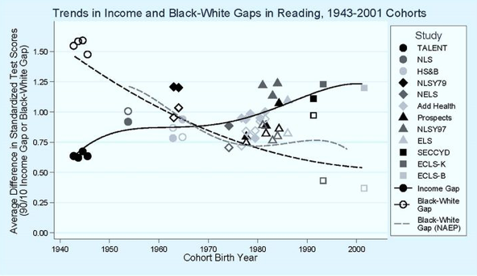
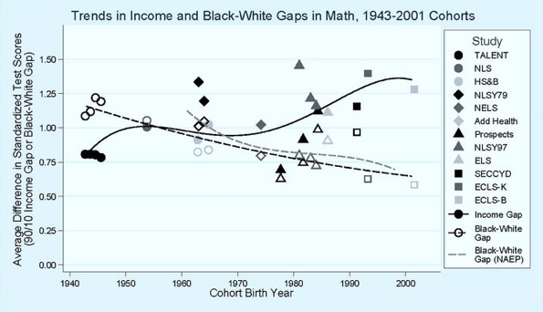
Could White People Be a “Genetic Elite”?
I’m afraid this is intellectual garbage collection:
In a stable population, the typical person has 1000 descendants in 250 years, and a million in 500
Advantageous genes mix very quickly through human populations
If a group is a “genetic elite”, it would have to share genes that (a) are not advantageous and do not spread across other groups when they leak across, (b) do spread throughout the chosen ones, and (c) somehow make the chosen ones “special”
What do IQ tests measure?
The Flynn effect: “Test score increases have been continuous and approximately linear from the earliest years of testing to the present. For the Raven's Progressive Matrices test, a study published in the year 2009 found that British children's average scores rose by 14 IQ points from 1942 to 2008…” (Flynn, James R. (March 2009). "Requiem for nutrition as the cause of IQ gains: Raven's gains in Britain 1938–2008". Economics and Human Biology. 7 (1): 18–27. doi:10.1016/j.ehb.2009.01.009. ISSN 1873-6130. PMID 19251490.)
Christopher Jencks & Meredith Phillips: “In America, 82 percent of those who took the Stanford-Binet test in 1978 scored above the 1932 average for individuals of the same age. The average black did about as well on the Stanford-Binet test in 1978 as the average white did in 1932..”
Sean Reardon: The Widening Achievement Gap Between Rich and Poor: New Evidence and Possible Explanations <https://github.com/braddelong/public-files/blob/master/readings/article-reardon-widening-achievement-gap.pdf>
4:45
Notes:
And now I have to do some intellectual garbage cleanup, unfortunately.
Might it be the case that humans are by nature unequal in important and salient aspects, and thus that it is injustice to treat them equally—to give African-Americans a vote, or to find the fact that they do not have equal wages a troubling problem to be remedied?
Some, like the American Enterprise Institute is Charles Murray, seem to say “yes”: that African-Americans are systematically and substantially less intelligent, hence less worthy and in a just social order would have fewer of the good things of life, than American whites. Perhaps they should not share equally in governance either—being systematically and substantially less intelligent by nature.
Charles Murray, when he was in high school, decided that a good thing to do would be to burn a Ku Klux Klan cross to scare the shit out of the less than ten African-American families living nearby his Indiana home. My former research assistant Jon Gruber was, when young, impressed by Murray’s book Losing Ground. But as he learned more: “reading the book moved me a notch to the right… really challenged the way I thought. It turned out his facts were largely wrong, so it’s really more a book to read for an example of how someone can shift the debate with potent use of clear arguments…”
Could white people be a cognitive “genetic elite”? No. And if there is such a thing, I’m afraid that Charles Murray isn’t part of it, because being a part of it requires being motivated and able to do arithmetic.
Consider: In a stable population, the typical person has 1000 descendants in 250 years, and a million in 500. Advantageous genes mix very quickly through human populations.
“Whites”—people who moved north when the glaciers retreated, and whose surviving descendants quickly lost their melanin-producing genes in order to allow them to make enough vitamin D—have been around for 10000 years or so, and have been mixing their genes with Africans for that long. If they had powerfully advantageous mutations that made them “better” that had spread throughout the population… those genes would have leaked to and spread among other human populations long, long ago.
If a group is a “genetic elite”, it would have to share genes that (a) are not advantageous and do not spread across other groups when they leak across, (b) do spread throughout the chosen ones, and (c) somehow make the chosen ones “special”. That thought seems to be just confused.
And then there is the question: What do IQ tests measure? They measure achievement, not moral worth. And group differences overwhelmingly reflect group differences in average environment that lead to lower or higher achievement.
The Flynn effect: “Test score increases have been continuous and approximately linear from the earliest years of testing to the present. For the Raven's Progressive Matrices test, a study published in the year 2009 found that British children's average scores rose by 14 IQ points from 1942 to 2008…” (Flynn, James R. (March 2009). "Requiem for nutrition as the cause of IQ gains: Raven's gains in Britain 1938–2008". Economics and Human Biology. 7 (1): 18–27. doi:10.1016/j.ehb.2009.01.009. ISSN 1873-6130. PMID 19251490.)
Christopher Jencks & Meredith Phillips: “In America, 82 percent of those who took the Stanford-Binet test in 1978 scored above the 1932 average for individuals of the same age. The average black did about as well on the Stanford-Binet test in 1978 as the average white did in 1932.”
Over the past two generations, 2/3 of the white-Black achievement gap has vanished; while the rich-poor achievement gap has increased by half. It’s not our genes. Genes don’t change that fast.

Slide 7
Could Rich People Be a “Genetic Elite”?
I’m afraid this is intellectual garbage collection too:
Bowles & Gintis:
“A standard deviation change in the cognitive score, holding constant the remaining variables (including schooling), changes the natural logarithm of earnings by about one-seventh of a standard deviation….
“If the heritability of IQ were 0.5 and the degree of assortation, m, were 0.2 (both reasonable, if only ball park estimates) and the genetic inheritance of IQ were the only mechanism accounting for intergenerational income transmission, then the intergenerational correlation would be 0.01, or roughly two percent the observed intergenerational correlation. Note the conclusion that the contribution of genetic inheritance of IQ is negligible is not the result of any assumptions concern- ing assortative mating or the heritability of IQ: the IQ genotype of parents could be perfectly correlated and the heritability of IQ 100 per cent without appreciably changing the qualitative conclusions. The estimate results from the fact that IQ is just not an important enough determinant of economic success…
2:00
Notes:
Could rich people be a genetic elite? I’m afraid this is intellectual garbage collection too. Sam Bowles & Herb Gintis wrote
>A one standard deviation change in the cognitive score, holding constant the remaining variables (including schooling), changes the natural logarithm of earnings by about one-seventh of a standard deviation….
>If the heritability of IQ were 0.5 and the degree of assortation, m, were 0.2 (both reasonable, if only ball park estimates)…
The "degree of assortation" is the extent to which high IQ people tend to marry other high IQ people.
>…and [if] the genetic inheritance of IQ were the only mechanism accounting for intergenerational income transmission, then the intergenerational correlation would be 0.01, or roughly two percent of the observed intergenerational correlation.
Two percent. One-fiftieth. Note that. The heritability of income in America today is about 0.5. Of that 0.5, the genetic inheritance component is 0.01. The amount of the 0.5 intergenerational transmission of economic inequality that is due to high-income parents being high-IQ parents, then transmitting their good-IQ genes to their children, their children then showing a high-IQ phenotype, and that phenotype leading them to have higher incomes is 0.01.
Bowles and Gintis continue:
>Note the conclusion that the contribution of genetic inheritance of IQ is negligible is not the result of any assumptions concerning assortative mating or the heritability of IQ: the IQ genotype of parents could be perfectly correlated and the heritability of IQ 100 per cent without appreciably changing the qualitative conclusions. The estimate results from the fact that IQ is just not an important enough determinant of economic success.

Slide 8
“Time & Chance…”
Contrast:
Andrew Carnegie: “The price which society pays for the law of competition… is also great… [but] while the law may be sometimes hard for the individual, it is best for the race, because it insures the survival of the fittest in every department. We accept and welcome therefore… great inequality of environment, the concentration of business, industrial and commercial, in the hands of a few, and the law of competition between these, as being not only beneficial, but essential for the future progress of the race…. That… talent for organization and management is rare among men is proved by the fact that it invariably secures for its possessor enormous rewards…. The MAN whose services can be obtained as a partner [is] not only the first consideration, but such as to render the question of his capital scarcely worth considering, for such men soon create capital; while, without the special talent required, capital soon takes wings…”
Ecclesiastes 9:11: “I returned, and saw under the sun, that the race is not to the swift, nor the battle to the strong, neither yet bread to the wise, nor yet riches to men of understanding, nor yet favour to men of skill; but time and chance happeneth to them all…”
2:15
Notes:
And yet… and yet… and yet… Many, many people with very large megaphones speaking in the public sphere really want for white people—or the right white people—or for rich people to be especially smart, and thus especially worthy of having more of the good things of life as members of some sort of genetic elite. Because they wish it so much, they work very very hard so that they can pretend to themselves that they think it's so. Yet there were people 3000 years ago who were wiser, the author of the Hebrew Bible's book of Ecclesiastes being one such.
Contrast the views of late 1800s American industrialist plutocrat robber baron Andrew Carnegie with those of the author of Ecclesiastes, expressed in chapter 9 verse 11. First, Carnegie:
>The price which society pays for the law of competition… is also great… [but] while the law may be sometimes hard for the individual, it is best for the race, because it insures the survival of the fittest in every department. We accept and welcome therefore… great inequality of environment, the concentration of business, industrial and commercial, in the hands of a few, and the law of competition between these, as being not only beneficial, but essential for the future progress of the race…. That… talent for organization and management is rare among men is proved by the fact that it invariably secures for its possessor enormous rewards…. The MAN whose services can be obtained as a partner [is] not only the first consideration, but such as to render the question of his capital scarcely worth considering, for such men soon create capital; while, without the special talent required, capital soon takes wings…
Next, the one who calls the people to assemble and listen:
>I returned, and saw under the sun, that the race is not to the swift, nor the battle to the strong, neither yet bread to the wise, nor yet riches to men of understanding, nor yet favour to men of skill; but time and chance happeneth to them all…

Slide 9
Black Congressmen
No Black members of congress from 1901 to 1929:
Eight African-Americans served in congress in 1875-77
That number was not to be exceeded until 1969-71
1929: Republican Oscar Stanton De Priest from Southside Chicago.
1945: Adam Clayton Powell from Harlem
1955: Clarence Diggs from Michigan
1958: Robert Nix from Pennsylvania
1963: Augustus Hawkins from California
1965: John Conyers from Michigan
Four African-American congressmen, all Democrats, in the last pre-Voting Rights Act congress…
3:30
Notes:
In the aftermath of the Civil War the Republican Party had a commitment to African-American uplift, as part of its belief in “free labor”. In the first few years after WWII it retained that ancestral commitment.
But Myrdal’s “American creed” managed to coexist with official state-sanctioned discrimination and disenfranchisement for another full century. In the south African-American disenfranchisement was settled policy, overwhelmingly popular among whites. There were no southern Black congressmen from 1901 to 1973, when Barbara Jordan from Texas and Andrew Young from Georgia took office.
In the north there were, up until the Great Migration, too few African Americans for it to matter. Even after the migration was underway, African-American congressmen were very few. The first northern African-American congressman did not take office until 1929, when Republican Oscar Stanton De Priest was elected to represent the majority-minority district in Southside Chicago. A second congressman joined the Southside’s representative when Adam Clayton Powell from Harlem took office in 1945. Then came Charles Diggs from Michigan in 1955, Robert Nix from Pennsylvania in 1958, Augustus Hawkins from California in 1963, and John Conyers from Michigan in 1965. There were thus four African-American congressmen, all Democrats, in the last pre-Voting Rights Act congress.
Eight African-Americans served in congress in 1875-77. That number was not to be exceeded until 1969-71, when 10 Democratic congressmen plus Republican Senator Ed Brooke from Massachusetts were in the legislature. 17 served in 1979-81, 24 in 1989-91, 38 in 1999-2001, 42 in 2009-11, and 56 (including Republican Senator Tim Scott) serve today.
Representation at the congressional district level is very healthy. And yet nearly half of the states have voting restrictions that appear targeted with laser-like precision at reducing the share of African-American votes. A majority of Supreme Court justices pretend to believe that these are partisan restrictions imposed by Republican Party legislators to give them an edge over the Democratic Party in the next election, rather than racist restrictions to keep Black men and women down. But in a context where Republican Party political standard-bearers like Ronald Reagan talk of diplomats from Tanzania as “monkeys from those African countries—damn them, they're still uncomfortable wearing shoes!” And economic-policy standard-bearers like the University of Chicago’s George Stigler writes of African-American demonstrations for political and civil rights as “growing in size and insolence”, I do not see the distinction that the Supreme Court majority is willing to draw.
And there are still some who think that the Democratic Party’s rejection at its 1964 convention of a Mississippi delegation with no African-American representation was a big mistake.

Slide 10
Making Progress
As of 1940, a three-year education gap:
Discrimination in employment widely applauded
The near consensus was that infringement on individual liberty to outlaw people’s power to discriminate on the basis of race in the use of their property
African-American male college graduates made half of what white high school graduates made
48% of whites below today’s poverty line, 81% of African-Americans
Yet today:
AA men’s weekly wages 67% of whites
AA women’s 95% of whites
The Civil Rights leaders played an extremely weak hand with immense skill and patience
2:30
Notes:
As of 1940, the average African-American worker in the United States had three years fewer of education than the average white worker. A substantial majority of white Americans approved of discrimination—in employment, in housing, in education, and in voting. African-American men were concentrated in unskilled agricultural labor, primarily in the low-productivity and low-income (even for whites) south of the United States; African-American women were concentrated in unskilled agriculture and in domestic service. Both were extremely low-paid occupations: African-American men and women earned an average weekly wage some forty-five percent of their white counterparts. African-American male college graduates earned some $280 a week (in today’s dollars); white high school graduates earned some $560 a week. In 1940 some 48 percent of white families fell below today’s “poverty line” according to official statistics; some 81 percent of African-American families were in poverty.
An absence of political power, being stripped by slavery of the ability to accumulate property, the politics of using racial discrimination as a weapon to keep southern mass electorates from seeking a less inegalitarian distribution of wealth in the U.S. south, and the bad conscience of a white majority that could not forgive African-Americans for by their very existence reminding whites of their ancestors’ and predecessors’ bad deeds—all kept the Black man and woman down.
And discrimination is still a very real reality in America today.
Yet as of today things are very different. Virtually all whites would publicly espouse the principle of equal employment opportunity for African-Americans. Educational attainment by race was almost identical for those finishing school in the late 1980s and 1990s. African-American men’s average weekly wages were two-thirds those of whites; African-American women’s average weekly wages were more than ninety-five percent those of whites on average. It is impossible not to credit the change to the extremely wise leadership and the extremely skillful use of moral force by the leadership of the African-American community. Civil rights leaders played an extremely weak hand with immense skill and patience, and with extraordinary long-run success. They are among the greatest of the heroes of the twentieth century.

Slide 11
Sources of Black-White Partial Convergence
Four principal factors in progress 1940-1980:
The end of formal, legal, state-sanctioned discrimination
The migration of African-Americans from the rural south to the urban north
The associated shift from low-paid low-skill agricultural employment to industrial and service industries
Title VII of the 1964 Civil Right Act made employment discrimination on the basis of race illegal
Yet since 1980 convergence has stalled out:
By the end of the 1980s at least one in five of African-American prime-aged men (aged 25-54) reported no earnings in a given calendar year
Real per capita family income for African-Americans today is still only some sixty percent of whites
Why?
2:00
Notes:
The major sources of gains in the 1940 to 1970 generation involved four factors: the end of formal, legal, state-sanctioned discrimination; the migration of African-Americans from the rural south to the urban north; the associated shift from low-paid low-skill agricultural employment to industrial and service industries. The period was accompanied by large increases in African-American’s educational levels, and high rates of employment growth and productivity growth in the rest of the economy. Title VII of the 1964 Civil Right Act made employment discrimination illegal. There is every reason to think that civil right enforcement made a significant difference in speeding the economic advance of African Americans. Employment discrimination lawsuits acted as a spur to boost hiring. Government contractors expanded their African-American workforces much faster than did non-contractors.
The period from 1940 to 1970 was one of substantial relative advance. The picture from 1970 to today was more mixed. By the end of the 1980s at least one in five of African-American prime-aged men (aged 25-54) reported no earnings in a given calendar year. Real per capita family income for African-Americans today is still only some sixty percent of whites: almost exactly what it had been at the end of the 1960s.

Slide 12
The Rising Significance of Class
General inequality rise first; family structure changes second:
The extraordinary rise in income and wealth inequality since 1980
The rise in single-parent households
The poverty rate for two-parent African-American families with children today is 12.5%
The poverty rate for single-parent African-American families with children today is 40%
Right-wing claim: Charles Murray & George Gilder & c.: more generous welfare payments triggered the collapse of the African-American family by making it more profitable to be on the dole than to keep a man
Haven’t done their arithmetic:
By the mid-1990s welfare payments were lower in inflation-adjusted terms than they had been in 1960
Real wages were some fifty percent higher for African-American males.
Maintaining a two-parent household was, in material terms, a much more advantageous option relative to split-up and welfare receipt in the 1990s than it had been in the 1950s and 1960s
Backwash: Links Between Economic and Cultural Changes:
Divorce no longer stigmatized for males:
The 1980s saw the election of America’s first divorced president, Ronald Reagan
By the 1990s the children of one Speaker of the House of Representatives—the Republican Newt Gingrich—had grown up in a single-parent family
Plus families do not hold together when economic uncertainty is rife
Seminal document of Murray-Gilder: a mid-1960s document written by a then-Johnson administration policymaker: Daniel Patrick Moynihan: The Negro Family: The Case for National Action:
But Moynihan’ vision was shaped more by Moynihan’s memories of Irish-American family dynamics under material pressure than an analysis of African-American families
3:15
Notes:
The less favorable relative income performance since 1970 had two causes. Chief among them is the rising significance of class.
Most important was a general, economy-wide cause: the growth in income inequality as employers’ relative demand for less-skilled and educated workers diminished.
The second were changes in family structure: the rise in divorce, the rise in births outside of marriage, and the consequent rise in single-parent almost inevitably female-headed households. The poverty rate for two-parent African-American families with children today is 12.5%. The poverty rate for single-parent African-American families with children today is 40%. It is still the case than half of African-American children in the last decades of the twentieth century spent more than half their childhood below the poverty line.
The right-wing explanation for the decline in African-American two-parent families—the explanation provided by ideologists like Charles Murray and George Gilder—was that more generous welfare payments had triggered the collapse of the African-American family. But it was hard to escape the conclusion that those advancing this traditional explanation simply had not done their arithmetic. Welfare and food stamp payments for a mother with three children rose by one-third between 1960 and 1970, but then declined. By the mid-1990s welfare payments were lower in inflation-adjusted terms than they had been in 1960; real wages were some one-third higher—some fifty percent higher for African-American males. Maintaining a two-parent household was, in material terms, a much more advantageous option relative to split-up and welfare receipt in the 1990s than it had been in the 1950s and 1960s. A better explanation was that African-American families were caught in the backwash of broader society-wide changes—but were especially vulnerable to them. The 1980s saw the election of America’s first divorced president, Ronald Reagan. By the 1990s the children of one Speaker of the House of Representatives—the Republican Newt Gingrich—had grown up in a single-parent family. And trends in the 1990s suggested that a majority of white children in America would spend at least some time in a single-parent household. This should not have come as a surprise. Families do not hold together well when economic uncertainty is rife. Indeed, the seminal work out of which thinkers like Murray and Gilder constructed their interpretation was a mid-1960s document written by a then-Johnson administration policymaker: Daniel Patrick Moynihan. But Moynihan’s The Negro Family: The Case for National Action was shaped more by Moynihan’s memories of Irish-American family dynamics under material pressure than an analysis of African-American families either responding to welfare-state incentives or in the grip of non-optimal cultural patterns.
The promissory note remains, in large part, in default.

Slide 13

Sources of Hope…
Promissory note remains in substantial arrears:
But we care
Or, at least, it is impolite to acknowledge that you do not care about ethnic, gender, and status-group inequality
That is itself a big difference about how things were 100 years ago
Moving goalposts & ethnogenesis:
Being on a conference panel with Muhammed El-Erian
Mark Krikorian in 2007, executive director of the “Center for Immigration Studies”…
1:30
Notes:
Although the promissory note remains in substantial arrears, there is cause for enormous hope. First there has been enormous progress. We do care. Or, at least, it is impolite to acknowledge that you do not care about ethnic status group and gender based inequality.
This is in itself a huge difference between how things were 100 years ago and how they are.
Second, ethnogenesis and goalpost moving confuses the issues.
I remember being on a four person conference panel perhaps a decade ago: me, white-bread WASP, that is, white Anglo-Saxon Protestant; Martin Wolf, British Tory descended from Germano-Polish Ashkenazim; Larry Summers, also Jewish; and Muhammed El-Erian. And our panel was dismissed by some as “just another four white men”.
From one perspective, that people could see the four of us and see four white men—rather than one white man, and a bunch of “oriental” types, as would have been the case a century ago—is a statement of how much progress has been made.
And then there is the amusing item in my tickler file from 2007. Mark Krikorian—a good old highly Armenian-American last name—who was then holding himself out as executive director of the “Center for Immigration Studies”—not that anyone

Slide 14

Mark Krikorian? WAT?
Pizza Patrón in East Dallas, one of 59 in five Southwestern and Western states:
Antonio Swad, president and founder of Pizza Patrón
Italian-Lebanese and was born and raised in Columbus, Ohio
Saw a business opportunity in the growing Latino minority in his neighborhood
Changed the name from Pizza Pizza to Pizza Patrón, hired bilingual staff members and added items like La Mexicana, a pizza that includes spicy chorizo sausage and jalapeños
Mark Krikorian, executive director of the Center for Immigration Studies in Washington, a group that seeks to limit immigration, said he was concerned that Hispanics could create a parallel mainstream in the United States. “It's a trivial example, but Hispanics now have their own pizza chain,” Mr. Krikorian said. "It's a consequence of having too many people arrive from a single foreign culture, and may well reflect a kind of cultural secession…”
3:15
Notes:
A New York Times reporter was looking for quotes about a “pay for your pizza in pesos” promotion that Pizza Patron, a chain in the southwest with 59 franchises, was running.
Antonio Swad, president and founder of Pizza Patrón, is of Italian-Lebanese extraction. He was born and raised in Columbus, Ohio. He saw a business opportunity in the growing Latino minority in his neighborhood.
So he changed the name of his pizza place to Pizza Patrón, hired bilingual staff members and added items like La Mexicana, a pizza that includes spicy chorizo sausage and jalapeños.
The New York Times thought this would be red meat for Mark Krikorian. To quote from the article:
>Mark Krikorian, executive director of the Center for Immigration Studies in Washington, a group that seeks to limit immigration, said he was concerned that Hispanics could create a parallel mainstream in the United States. “It's a trivial example, but Hispanics now have their own pizza chain,” Mr. Krikorian said. "It's a consequence of having too many people arrive from a single foreign culture, and may well reflect a kind of cultural secession…”
My first thought: cultural secession is keeping your ancestors’ last name “Krikorian” rather than changing it to “Kirk”, either at Ellis Island or since. Admittedly, Krikorian claims his objection is not to Hispanics but to “too many people arriving from a single foreign culture”. But the point of the 1924 immigration restrictions was that too many Italians were coming, and bringing too many of their alien non-WASP customs with them—like pizza.
The cheek of complaining that Hispanics are not eating good old standard American pizza but are rather adding chorizo—as opposed to Calebrese—sausage to it, posing as a defender of WASP cultural matrix and ascendancy, while bearing a name like Krikorian. That someone can do that is testimony to assimilation in a very strong sense—and thus to the success of the inclusion that he wants to make a good living by fighting against.

Slide 15
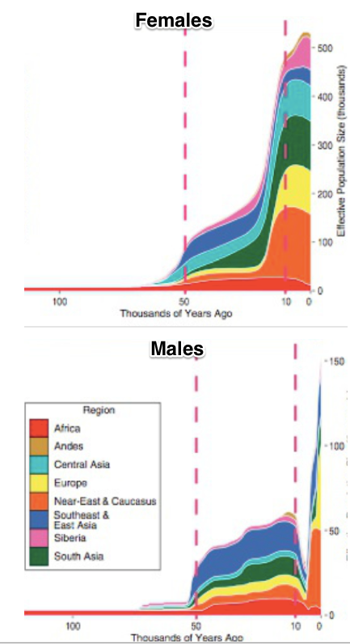
Inclusion: Feminism
High patriarchy—and men take advantage:
Extinction of y-chromosome lineages
But even afterwards: patriarchy
Emancipation of women comes late: following the political strategies of franchise and rights extension, but happening a century or so later…
Women rarely have legal personality…
Childbed mortality: 1 in 7
Eating for two: 20 years
Employment: textiles, gardening, in-home production, other occupations with savable state
28:30 of audio
4:45
Notes:
But it is not just ethnicity that was a dimension of exclusion. There is gender as well.
Why male supremacy had been such a thing in history for such a long time is not clear to me. But it was.
Indeed, gender inequality in the age human societies that flourished between -5000 and -2000 is literally inscribed in our genes.
It is an elementary fact of our genetics that there is a small proportion of our genome—the mitochondrial DNA genome—that we inherit only from our mothers. Thus we can trace descent back through the exclusively female line, and by looking at the amount of mutations and genetic divergence in a human population today in that portion of the genome, determine the effective female population size of the human race back in the past all the way back to mitochondrial Eve: the woman who is the mother's mother's mother's... mother's mother's mother of us all.
And It is an elementary fact of our genetics that there is a small proportion of every male's genome—the y-chromosome genome—that we inherit only from our fathers. Thus we can trace descent of males back through the exclusively male line, and by looking at the amount of mutations and genetic divergence in a human population today in that portion of the genome, determine the effective male population size of the human race back in the past all the way back to y-chromosome Adam: the father who is our father's father's father's... father's father's father of us all.
When we do this, we find something going on between the years -5000 and -2000 according to our calendar.
Those who study the evolution of the genome see rough balance in the survival of mitochondrial and Y chromosomal lineages up to -5000. They see rough balance in the survival of mitochondrial and Y chromosomal lineages since -2000. But from -5000 to -2000, however, they see 15 female mitochondrial lineages survive for every single male Y chromosomal lineage that survives.
The effective female population size becomes much much much much larger than the effective male population size, and then they resume the rough equality that they had had before the year -5000 and since the year -2000. But in between, well, the overwhelming bulk of women are having daughters who have daughters... whose daughters' daughters' daughters are among us. A smaller percentage of men are. Only a small proportion of men breed, and then their sons breed and their sons breed, so that the chain is such that their sons'... son's sons are us.
This would seem to mean that -5000 to -2000 saw substantial polygyny for a few men, and non-reproduction for others. It also means the inheritance of male reproductive advantage: that if your great-grandfather had the resources to have more than one wife, the odds were higher that you were at the top of the inequality pyramid and had the resources to have more than one wife as well. Patriarchal reproductive inequality was in that age both substantial and inherited.
This is polygyny: one man, many wives—and lots of men with no wives and little sexual access to women. This is the Biblical Patriarch Jacob: 13 children with two wives and two concubines. Jacob and Leah's children were Reuben, Simeon, Levi, Judah Issachar, Zebulun, and Dina; Jacob and Rachel's children were Joseph and Benjamin; Jacob and Zilpah's children were Gad and Asher, and Jacob and Bilhah's children were Dan and Naphtali. And somewhere in the neighborhood there were three men—unnamed—who were without wives, and without children. Leah, Rachel, Zilpah, and Bilhah's mitochondrial DNA lineages were passed down. The three nameless men's y-chromosome lineages were not: only Jacob's was.
Maintaining polygyny for a number of generations requires great social pressure and great societal inequality among men. It also requires a great deal of subservience among women. Back in the age -5000 to -2000, women were, to a substantial degree, property: the property of their fathers, and then of those in the patriarchal polygynous network who gained control over them. And back in the age -5000 to -2000, a great many men were without resources‚ for the overwhelming majority of men would, if they had resources to deploy to attain any form of social power, would have chosen to use those resources to marry. And yet many of them could not do so.
This age of super-patriarchy stands out in our genetic record. The social structures and institutions to support it are not there before -5000 and do not persist since -2000.
What was human life and human inequality like back in this patriarchal age? What brought it on? What made it come to an end?
What was life like for women in those 3000 years?

Slide 16
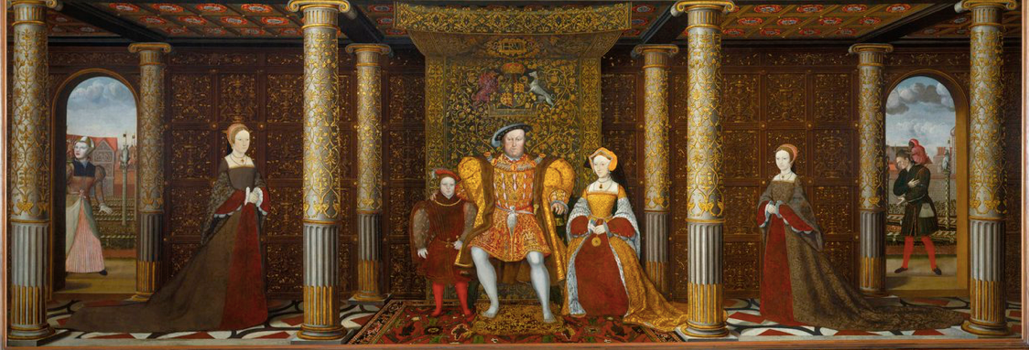
Childbed: British Queens
16 generations from Henry IV to Victoria
5 queens (or heiresses apparent) dead in childbed: Charlotte (Victoria’s generation), Catherine Parr, Jane Seymour, Elizabeth of York, Mary de Bohun
At an average of two queens per generation, this is a 16% childbed mortality rate for the most cosseted women in England
2% maternal mortality per birth
1% extra mortality per child from caring for sick children
1:30
Notes:
Even after the end of the age of polygyny, gender inequality was fierce and vicious.
A good deal of it was the result of the fact that humanity in the agrarian age found itself under the Malthusian hammer: because our technology was good enough for us to dominate nature, only disease and near-starvation kept our numbers in check.
The disease burden—and the fact about human biology that we are very close to the edge, trading off in evolutionary terms bigger brain sizes against difficulties in childbirth—meant that being female before modern medicine was not for sissies.
Conider the queens of England in the generations from Henry IV to Victoria. There were 32 queen in those years. Five of them—Catherine Parr, Jane Seymour, Elizabeth of York, Mary de Bohun, and let’s throw in Victoria’s cousin and more senior in the succession, Crown Princess Charlotte—died in childbed. This is a 16% childbed mortality rate for the most cosseted women in England. There was, back in the agrarian age, a 2% chance that each baby you had would kill you—and an extra 1% chance that you would be carried off while caring for that child when he or she suffered from the diseases that made infant mortality so high.
This Malthusian era biological load greatly constrained typical women’s lives. And men took great advantage.

Slide 17
Women in Their Place…
Biology…
16% childbed mortality; 8% excess nursing sick mortality…
3 yr x 7? 20 years eating for two?
Occupations…
Elizabeth Wayland Barber (1995): Women's Work: The First 20,000 Years Women, Cloth, and Society in Early Times (0393035069) <http://amzn.to/2BSw3fZ>
Patriarchy…
Societal expectations…
Interactions
Disparate impact
Even in Denmark today:
7% lower employment probability
7% lower hours per week conditional on employment
7% lower wages and salaries conditional on employment and hours…
1:15
Notes:
Moreover, there was an energy burden. Growing a baby is hard, energy intensive work. Nursing a baby is hard, energy intensive work as well. The typical agrarian age woman spent perhaps 20 years eating for two. And that was a substantial energy drain.
Moreover, the fact that we are mammals meant that whatever other activities a mother with young children undertook, they could not take her too far from the still-nursing for too long.
Hence women’s work became textiles, gardening, cooking, in home production where the task has stable state, so you can lay it down at any time and pick it up again half an hour later without degradation of the job.
Even today our societies have not figured out how to balance the mammalian special role of women with gender equality in careers. Even in a place like Denmark, women who have been mothers have a 7% lower employment probability, conditional on being employed they work 7% fewer hours for pay, and conditional on being employed and on their hours they receive 7% less per hour of work.

Slide 18
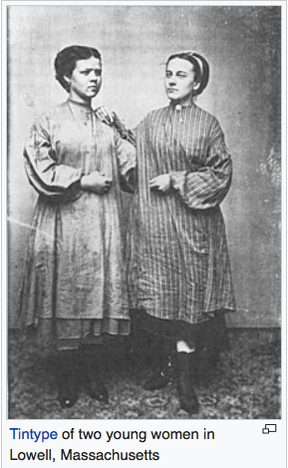
What Happened When Women’s Opportunities Opened Up—Even a Little?
Market income and factory work…
In 1840, in Lowell, unmarried young women (16-30) one quarter of the city’s industrial workforce.
Expected to attend church
“Not employ anyone… known to be guilty of immorality”
The Lowell mills in boom:
A way to acquire a dowry…
A way to have some extra freedom…
The Lowell mills in bust:
Labor organization…
1:15
Notes:
Whenever society allowed women out of the narrow motherhood-and-domestic-handmaid role, women took advantage. We see this in Massachusetts with the coming of the industrial revolution in the first half of the 1800s, and with the manufacturers’ desire to find a workforce that would work reliably without requiring the wages they would have needed to pay to pull strong men away from their farms. The merchants and manufacturers of Lowell settled on unmarried young women.
In 1840, in Lowell Massachusetts, unmarried young women (16-30) made up one quarter of the city’s industrial workforce.. They were expected to attend church. The mills would “not employ anyone… known to be guilty of immorality”. But otherwise, in boom times at least, they were desperate for young female workers. for whom working in the Lowell mills was a way to get out from under the thumbs of their fathers, a way to acquire a larger dowry, and a way to have some extra freedom to be their own boss before marriage.
They took to it like ducks to water. And when the Lowell mills went into bust in recession, they tried to organization themselves to share hour cutbacks and resist wage declines.
Marx and Engels were somewhat right: the market had little tolerance for high patriarchy when eroding it could gain them profits, and an enthusiastic but not too expensive labor force. And so it became patriarchy’s foe to a certain extent.

Slide 19
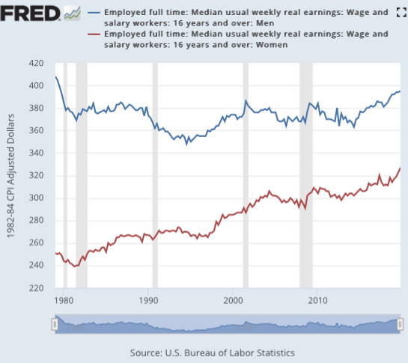
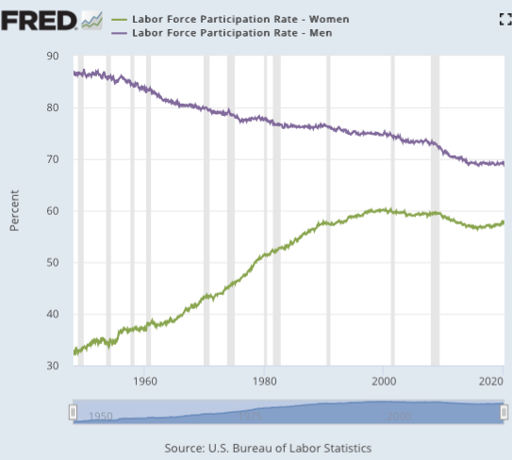
Wages and Paid Labor Force Participation
Wage gap from 67% to 25% since 1979
Share of women with jobs from 30% to 60%
Share of men with jobs from 85% to 70%
Aging
Longer schooling
7% “missing men”
Current female wage gap
Primarily a career-interruption childbearing gap
Women without interruptions in employment earn almost as much as men
Why should we think of this as unfair?
1:45
Notes:
The demographic transition drops typical pregnancies from eight to two. Birth control allows for planning when to have children. Literacy gives women knowledge. The underlying ideology of equality makes demands for women’s suffrage, and expanded women’s roles, hard to resist: the tree of Jefferson yields unsuspected fruit.
You can perhaps wonder about where all this is going: in today’s America, it appears that women are expected to do well more than half the childcare, all of the childbearing, all of the nursing, most of the housework, and still have equal careers in paid employment outside the home. Are these expectations simply another twist on patriarchy? To what extent are they consistent with women’s being at the door of the realm of freedom?
In America, the wage gap between full-time women and men has gone from 67% in 1979 to 25% today. The share of women seeking paying outside-the-home jobs has gone from 30% to 60%. The gap between men’s and women’s labor force participation rates has gone from 55%-points to 10%-points.
Moreover, the current female wage gap is primairly a career-interruption childbearing gap. Women without interruptions in their employment career earn almost as much as men. American women are now receiving educational credentials at a greater rate than men.
We would not say, as far as gender and its roles are concerned, that inclusion has progressed to the point where things are fair. We are not even sure what “fair” would mean here, exactly.
But there has been enormous progress in treating people as beings of equal significance.

Slide 20
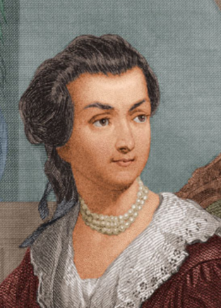
Abigail Smith Adams
<https://tinyurl.com/dl20180226a>: Letter to John Adams 31 Mar-5 Apr 1776…
Things to note about the letter as you read it:
Speling…
Public concerns:
Suspicion of Virginia…
State of Boston after the occupation…
Power of the colonies to resist…
Soapmaking… saltpeter… gunpowder…
Private concerns:
Family security…
“Gorge the Eldest… Billy the youngest… Becky Peck… your brother’s youngest child lies bad with convulsion fits…”
Why don’t you write more, and at longer length?
Feminist concerns…
1:00
Notes:
I like to either start or close lectures about gender roles, patriarchy, and inclusion with a letter from Abigail Smith Adams to her husband, future president John Adams, that she wrote in 1776. It is a famous letter. It is, to my mind, one of the most interesting windows into the dilemmas of a very smart and very uneducated late 18th century woman wanting more scope for herself and her life then society’s gender roles are willing to offer her. I would love to lecture on it here for another half an hour.
But I am already over time for this lecture. And I fear exhausting your patience further. So I am going to stop the audio portion here, and simply point you to the slides that remain in the deck. If there is demand, I will record the audio. But if I do, it will only be extra optional in the context of this course.

Slide 21
Document: Abigail Smith Adams
<https://tinyurl.com/dl20180226a>: Letter to John Adams 31 Mar-5 Apr 1776…
Braintree March 31, 1776: I wish you would ever write me a Letter half as long as I write you; and tell me if you may:
Where your Fleet are gone?
What sort of Defence Virginia can make against our common Enemy?
Whether it is so situated as to make an able Defence?
Are not the Gentery Lords and the common people vassals?
Are they not like the uncivilized Natives Brittain represents us to be?
I hope their Riffel Men who have shewen themselves very savage and even Blood thirsty; are not a specimen of the Generality of the people.
I [illegible] am willing to allow the Colony great merrit for having produced a Washington but they have been shamefully duped by a Dunmore.

Slide 22
Lots and Lots and Lots in This Letter: But Focus on:
I long to hear that you have declared an independency -- and by the way in the new Code of Laws which I suppose it will be necessary for you to make I desire you would Remember the Ladies, and be more generous and favourable to them than your ancestors. Do not put such unlimited power into the hands of the Husbands. Remember all Men would be tyrants if they could. If perticuliar care and attention is not paid to the Laidies we are determined to foment a Rebelion, and will not hold ourselves bound by any Laws in which we have no voice, or Representation.
That your Sex are Naturally Tyrannical is a Truth so thoroughly established as to admit of no dispute, but such of you as wish to be happy willingly give up the harsh title of Master for the more tender and endearing one of Friend. Why then, not put it out of the power of the vicious and the Lawless to use us with cruelty and indignity with impunity? Men of Sense in all Ages abhor those customs which treat us only as the vassals of your Sex. Regard us then as Beings placed by providence under your protection and in immitation of the Supreem Being make use of that power only for our happiness.

Slide 23
Abigail Smith Adams: Virginia/Boston
I have sometimes been ready to think that the passion for Liberty cannot be Eaquelly Strong in the Breasts of those who have been accustomed to deprive their fellow Creatures of theirs. Of this I am certain that it is not founded upon that generous and christian principal of doing to others as we would that others should do unto us.
Do not you want to see Boston? I am fearfull of the small pox, or I should have been in before this time.
I got Mr. Crane to go to our House and see what state it was in. I find it has been occupied by one of the Doctors of a Regiment, very dirty, but no other damage has been done to it. The few things which were left in it are all gone. Cranch has the key which he never deliverd up. I have wrote to him for it and am determined to get it cleand as soon as possible and shut it up. I look upon it a new acquisition of property, a property which one month ago I did not value at a single Shilling, and could with pleasure have seen it in flames.

Slide 24
Abigail Smith Adams: Boston
The Town in General is left in a better state than we expected, more oweing to a percipitate flight than any Regard to the inhabitants, tho some individuals discoverd a sense of honour and justice and have left the rent of the Houses in which they were, for the owners and the furniture unhurt, or if damaged sufficent to make it good.
Others have committed abominable Ravages. The Mansion House of your President is safe and the furniture unhurt whilst both the House and Furniture of the Solisiter General have fallen a prey to their own merciless party. Surely the very Fiends feel a Reverential awe for Virtue and patriotism, whilst they Detest the paricide and traitor.

Slide 25
Abigail Smith Adams: Optimism
I feel very differently at the approach of spring to what I did a month ago. We knew not then whether we could plant or sow with safety, whether when we had toild we could reap the fruits of our own industery, whether we could rest in our own Cottages, or whether we should not be driven from the sea coasts to seek shelter in the wilderness, but now we feel as if we might sit under our own vine and eat the good of the land.
I feel a gaieti de Coar to which before I was a stranger. I think the Sun looks brighter, the Birds sing more melodiously, and Nature puts on a more chearfull countanance. We feel a temporary peace, and the poor fugitives are returning to their deserted habitations.
Tho we felicitate ourselves, we sympathize with those who are trembling least the Lot of Boston should be theirs. But they cannot be in similar circumstances unless pusilanimity and cowardise should take possession of them. They have time and warning given them to see the Evil and shun it.

Slide 26
Abigail Smith Adams: “Your Sex… Naturally Tyrannical…”
I long to hear that you have declared an independency -- and by the way in the new Code of Laws which I suppose it will be necessary for you to make I desire you would Remember the Ladies, and be more generous and favourable to them than your ancestors. Do not put such unlimited power into the hands of the Husbands. Remember all Men would be tyrants if they could. If perticuliar care and attention is not paid to the Laidies we are determined to foment a Rebelion, and will not hold ourselves bound by any Laws in which we have no voice, or Representation.
That your Sex are Naturally Tyrannical is a Truth so thoroughly established as to admit of no dispute, but such of you as wish to be happy willingly give up the harsh title of Master for the more tender and endearing one of Friend. Why then, not put it out of the power of the vicious and the Lawless to use us with cruelty and indignity with impunity? Men of Sense in all Ages abhor those customs which treat us only as the vassals of your Sex. Regard us then as Beings placed by providence under your protection and in immitation of the Supreem Being make use of that power only for our happiness.

Slide 27
Abigail Smith Adams: Stripped of Two Lovely Children in One Week
April 5: Not having an opportunity of sending this I shall add a few lines more; tho not with a heart so gay. I have been attending the sick chamber of our Neighbour Trot whose affliction I most sensibly feel but cannot discribe, striped of two lovely children in one week. Gorge the Eldest died on wedensday and Billy the youngest on fryday, with the Canker fever, a terible disorder so much like the throat distemper, that it differs but little from it. Betsy Cranch has been very bad, but upon the recovery. Becky Peck they do not expect will live out the day. Many grown persons are now sick with it, in this street. It rages much in other Towns. The Mumps too are very frequent. Isaac is now confined with it. Our own little flock are yet well. My Heart trembles with anxiety for them. God preserve them.

Slide 28
Document: Abigail Smith Adams
I want to hear much oftener from you than I do.
March 8 [John to Abigail, 08 March 1776] was the last date of any that I have yet had.
-- You inquire of whether I am making Salt peter. I have not yet attempted it, but after Soap making believe I shall make the experiment. I find as much as I can do to manufacture cloathing for my family which would else be Naked. I know of but one person in this part of the Town who has made any, that is Mr. Tertias Bass as he is calld who has got very near an hundred weight which has been found to be very good. I have heard of some others in the other parishes. Mr. Reed of Weymouth has been applied to, to go to Andover to the mills which are now at work, and has gone.
I have lately seen a small Manuscrip describing the proportions for the various sorts of powder, such as fit for cannon, small arms and pistols [illegible]. If it would be of any Service your way I will get it transcribed and send it to you.
-- Every one of your Friends send their Regards, and all the little ones.
Your Brothers youngest child lies bad with convulsion fitts. Adieu.
I need not say how much I am Your ever faithfull Friend…

Slide 29
Abigail Smith and John Adams: Fecundity
Abigail Smith (20) married John Adams (30) in 1764:
Children:
Abigail ("Nabby") 1765–1813
John Quincy Adams 1767–1848
Grace Susanna ("Suky") 1768–70
Charles 1770–1800
Thomas Boylston Adams 1772–1832
Elizabeth (stillborn) 1777
Then they stopped…
She ran his Braintree-Boston operation…

Slide 30
Eating for Two
Abigail Smith Adams:
Abigail ("Nabby") 1765–1813
John Quincy Adams 1767–1848
Grace Susanna ("Suky") 1768–70
Charles 1770–1800
Thomas Boylston Adams 1772–1832
Elizabeth (stillborn) 1777
Likely a couple of miscarriages in there between 1772 and 1777…
Likely wetnursed…
Then they stopped, when she was 33…
Eight pregnancies to have four survive beyond the age of ten…
This is low child mortality…
Have a baby, lose a tooth…

Slide 31
Abigail Smith and John Adams: Terms of Partnership
She ran his Braintree-Boston operation…
Not just the inside-the-household part—pretty much the whole thing while he was being a High Politician…

Slide 32
Abigail Smith Adams: Social Roles
Abigail Smith (20) married John Adams (30) in 1764:
No formal schooling…
Not present at husband's presidential inauguration: caring for her dying mother…
At 74: "Do not grieve, my friend, my dearest friend. I am ready to go. And John, it will not be long."

Slide 33
John Adams’s Reply to Abigail
As to your extraordinary code of laws, I cannot but laugh.
We have been told that our struggle has loosened the bonds of government everywhere; that children and apprentices were disobedient; that schools and colleges were grown turbulent; that Indians slighted their guardians, and negroes grew insolent to their masters.
But your letter was the first intimation that another tribe, more numerous and powerful than all the rest, were grown discontented.
This is rather too coarse a compliment, but you are so saucy, I won't blot it out.
Depend upon it, we know better than to repeal our masculine systems. Although they are in full force, you know they are little more than theory. We dare not exert our power in its full latitude. We are obliged to go fair and softly, and, in practice, you know we are the subjects.
We have only the name of masters, and rather than give up this, which would completely subject us to the despotism of the petticoat, I hope General Washington and all our brave heroes would fight.

Slide 34
Readings…
Key readings:
George Abernethy: The Idea of Equality: An Anthology <https://github.com/braddelong/public-files/blob/master/readings/book-abernethy-equality.pdf>
Abigail Smith Adams (1776): Letter to John Adams <https://tinyurl.com/dl20180226a>
Aristotle: Politics <https://github.com/braddelong/public-files/blob/master/readings/book-selections-aristotle-politics-i.pdf>
Elizabeth Wayland Barber (1995): Women's Work: The First 20,000 Years: Women, Cloth, and Society in Early Times <https://github.com/braddelong/public-files/blob/master/readings/book-barber-women's-work.pdf>
Samuel Bowles & Herbert Gintis (2002): The Inheritance of Inequality <https://github.com/braddelong/public-files/blob/master/readings/article-bowles-gintis-inheritance-inequality.pdf>
Andrew Carnegie (1889): Wealth <https://github.com/braddelong/public-files/blob/master/readings/article-carnegie-wealth.pdf>
Christopher Jencks & Meredith Phillips (1998): The Black-White Test Score Gap: Why It Persists & What Can Be Done <https://www.brookings.edu/articles/the-black-white-test-score-gap-why-it-persists-and-what-can-be-done/>
Abraham Lincoln & Stephen Douglas (1858): Debates <https://github.com/braddelong/public-files/blob/master/readings/book-lincoln-douglas-debates.pdf>
Sean Reardon: The Widening Achievement Gap Between Rich & Poor: New Evidence & Possible Explanations <https://github.com/braddelong/public-files/blob/master/readings/article-reardon-widening-achievement-gap.pdf>

Slide 35
Catch Our Breath…
Ask a couple of questions?
Make a couple of comments?
Any more readings to recommend?

Slide 36
About the Course
The long 20th century will in all likelihood be seen in the future as the watershed in human experience:
Nine aspects:
History was primarily economic—and that was true for the first time…
Explosion of wealth: 2%+ per year…
Cornucopia of technology…
Demographic transition…
Feminist revolution…
Empowered tyrannies…
Wealth gulfs…
Inclusion and hierarchy attenuation…
Mismanagement and insecurity…
The global public health system and global epidemic transmission
Humanity is unlikely to see as transformative—for good and ill, but mostly for good, so far at least, I think—a century again…

Slide 37
Questions About Your Situation…
Things we would like to know:
Where do you expect to be located for the rest of the semester?
What aspect of our class are you most worried about?
What outside factors do we need to be aware of that impact your ability to participate in this class for the rest of the semester?
Beyond our class, what is your main worry for the upcoming weeks?
Do you have Wi-fi where you are staying?
Yes - on a computer or tablet
What kinds of devices do you have access to currently? Computer with a camera and microphone? Computer without a camera or microphone? Phone with a camera that can do video? Tablet with a camera that can do video?
Is s data usage a concern when viewing videos where you are?
Are you able to keep up with the lectures and class work? Is there anything challenging or beneficial to your learning in the new format?
What questions do you have for us?

Slide 38
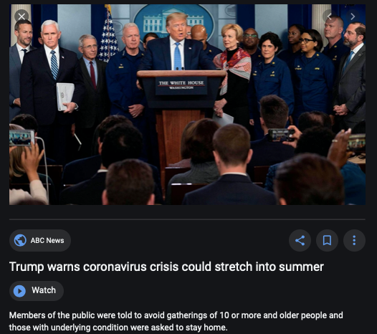
Coronavirus!

Slide 39
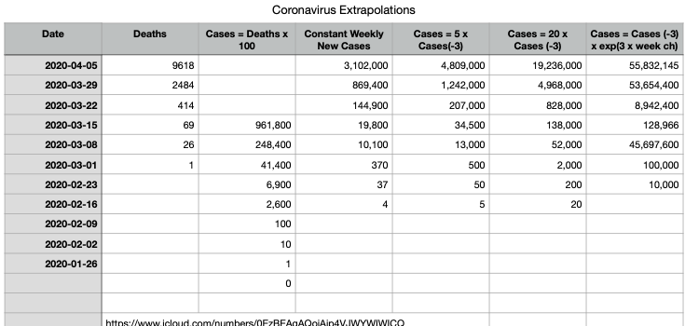
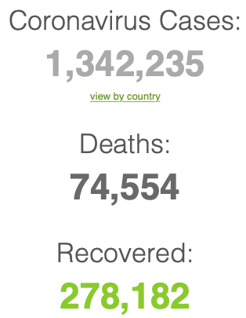
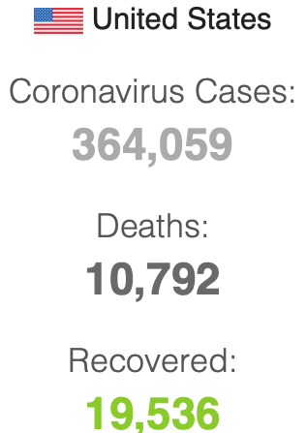

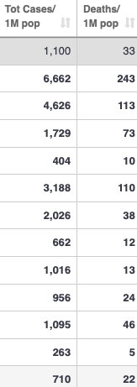
Coronavirus
Where we think we are, as of Mo Apr 6:
We really do not know
No random samples…
Best thing I have read comes from Jim Stock <https://drive.google.com/file/d/12MV466ZZy5xHir4xdPhoTrL1oO8CbZU-/view>:
The basic SIR epidemiological model of contagion
The effect of social distancing and business shutdowns on epidemic dynamics enters the model through a single parameter: the case transmission rate β
Re-express the model in terms of β and the asymptomatic (or not very symptomatic) hence non-tested rate—the fraction of the infected who are not tested
The COVID-19 non-testing rate is unidentified in our model
Estimates in the epidemiological literature range from 0.18 to 0.86.
The asymptomatic rate could be estimated accurately and quickly by testing a random sample
The optimal policy response and its economic consequences hinge critically on the asymptomatic rate

Slide 40
Where we think we are, as of Mo Apr 6:
We really do not know
No random samples…
Best thing I have read comes from Jim Stock <https://drive.google.com/file/d/12MV466ZZy5xHir4xdPhoTrL1oO8CbZU-/view>:
The basic SIR epidemiological model of contagion
The effect of social distancing and business shutdowns on epidemic dynamics enters the model through a single parameter: the case transmission rate β
Re-express the model in terms of β and the asymptomatic (or not very symptomatic) hence non-tested rate—the fraction of the infected who are not tested
The COVID-19 non-testing rate is unidentified in our model
Estimates in the epidemiological literature range from 0.18 to 0.86.
The asymptomatic rate could be estimated accurately and quickly by testing a random sample
The optimal policy response and its economic consequences hinge critically on the asymptomatic rate

Slide 44
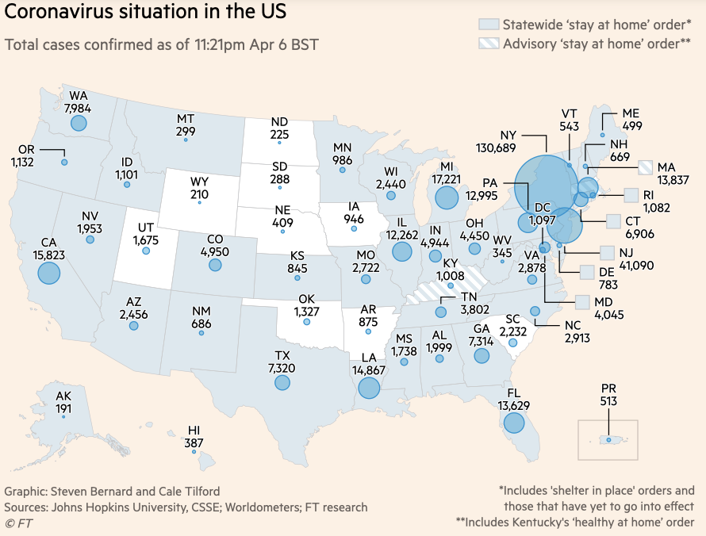
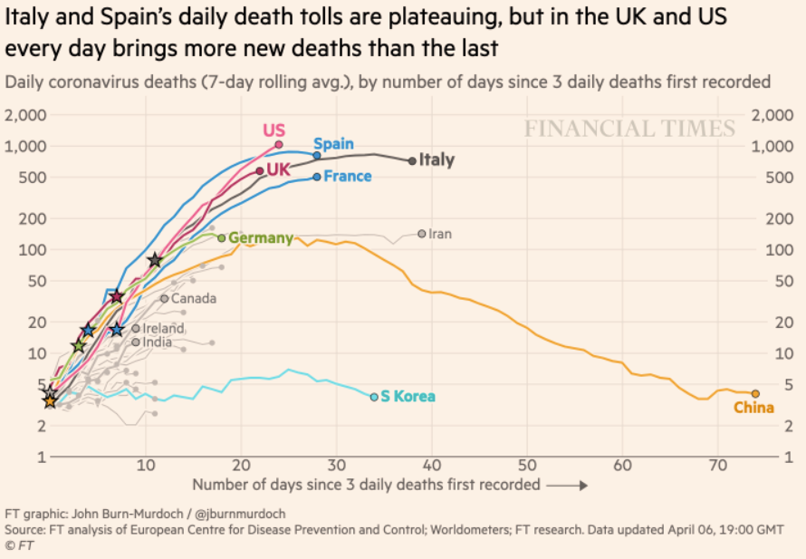
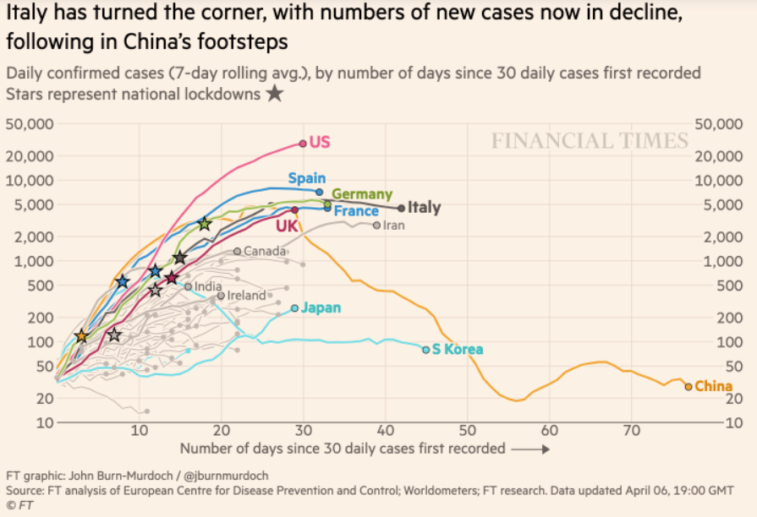
Financial Times Graphs Blown Up…

Slide 48
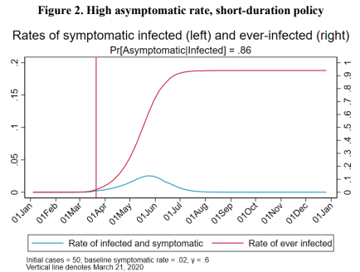
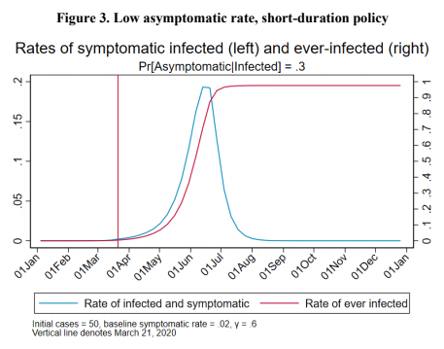
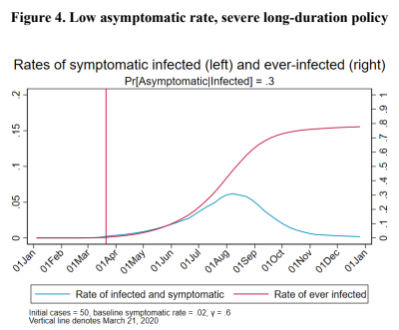
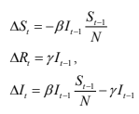
James Stock (2020)
Standard SIR model:<https://drive.google.com/file/d/12MV466ZZy5xHir4xdPhoTrL1oO8CbZU-/view>:
Susceptible, Infected, Recovered (& immune), transmission rate β, recovery rate γ, reproduction number R0, asymptomatic hence non-tested rate π0
Calibration: half-life of infection one week: γ = 0.5, s0 = 0.02, 50 cases on Jan 24
For March 21, 2020, the positive test rate in the United States is approximately 10%…
<https://drive.google.com/file/d/12MV466ZZy5xHir4xdPhoTrL1oO8CbZU-/view>

Slide 53
Bringing the Economy Back Up from Anæsthesia
Major issues:
Certificates of immunity:
Which requires test, test, test:
And not just disease virus tests
Presence-of-antibodies tests
How quickly can we match the immune with public-contact jobs?
What jobs can be done with minimal infection risk?
What minimal-infection substitutes can we find for previous jobs?
How quickly can restrictions be relaxed without the virus coming roaring back?
How do we avoid having the market give a “shutdown” signal to enterprises we in fact want restarted?
Which is pretty much all of them
How much of the potential caseload do we want to push out beyond the vaccine-arrival date?
ALL THESE QUESTIONS ARE ANSWERABLE IF WE LEARN THE ASYMPTOMATIC HENCE NON-TESTED RATE!!

Slide 54
Keeping the Economy from Crashing During the Lockdown
Nick Rowe: We have a 50% output cut in 100% of the sectors:
A temporary 100% output cut in 50% of the sectors (what the Coronavirus does) is very different from a 50% output cut in 100% of the sectors
Nick’s thought experiment:
In three months we are going to invent unobtanium:
Substantial intertemporal substitutibility
Plus lower cross-good contemporaneous substitutitbility
Hence high desired savings rate now
Flex-price market thus produces a nominal rate at the zero lower bound and a high inflation rate over the next three to six months
Plus liquidity-constrained workers in affected sectors see their demand go to zero immediately
Can we get there? Should we get there? What should we do instead?
We need a good RBC economist: are there any?…
<https://worthwhile.typepad.com/worthwhile_canadian_initi/2020/03/relative-supply-shocks-unobtainium-walras-law-and-the-coronavirus.html>

Slide 55
Keeping the Economy from Crashing During the Lockdown II
Nick Rowe <https://worthwhile.typepad.com/worthwhile_canadian_initi/2020/03/relative-supply-shocks-unobtainium-walras-law-and-the-coronavirus.html>:
Plus: to extend the thought experiment:
We just lost the ability to make “unobtainium”
So we should be substituting leisure for work, and moving workers into relatively unproductive labor, making the commodities we can still produce right now
How should relative prices move as a result? How should we make them move?
Plus: distributional issues
Plus: bankruptcy and credit chain issues

Slide 56
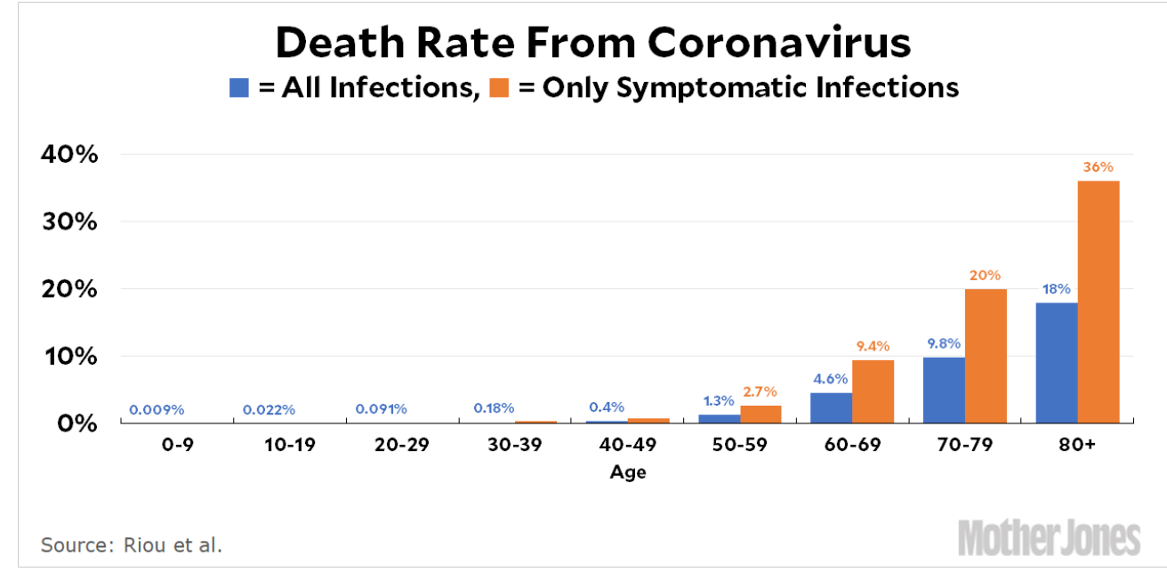
MOAR Coronavirus!
Death for Geezers!
Mortality for the Youngs very low…
It’s the flu for them—for you…
And an extra doubling—or is it 5%?—mortality for the asthmatic
And an extra doubling—or is it 5%?—mortality for the overweight

Slide 57
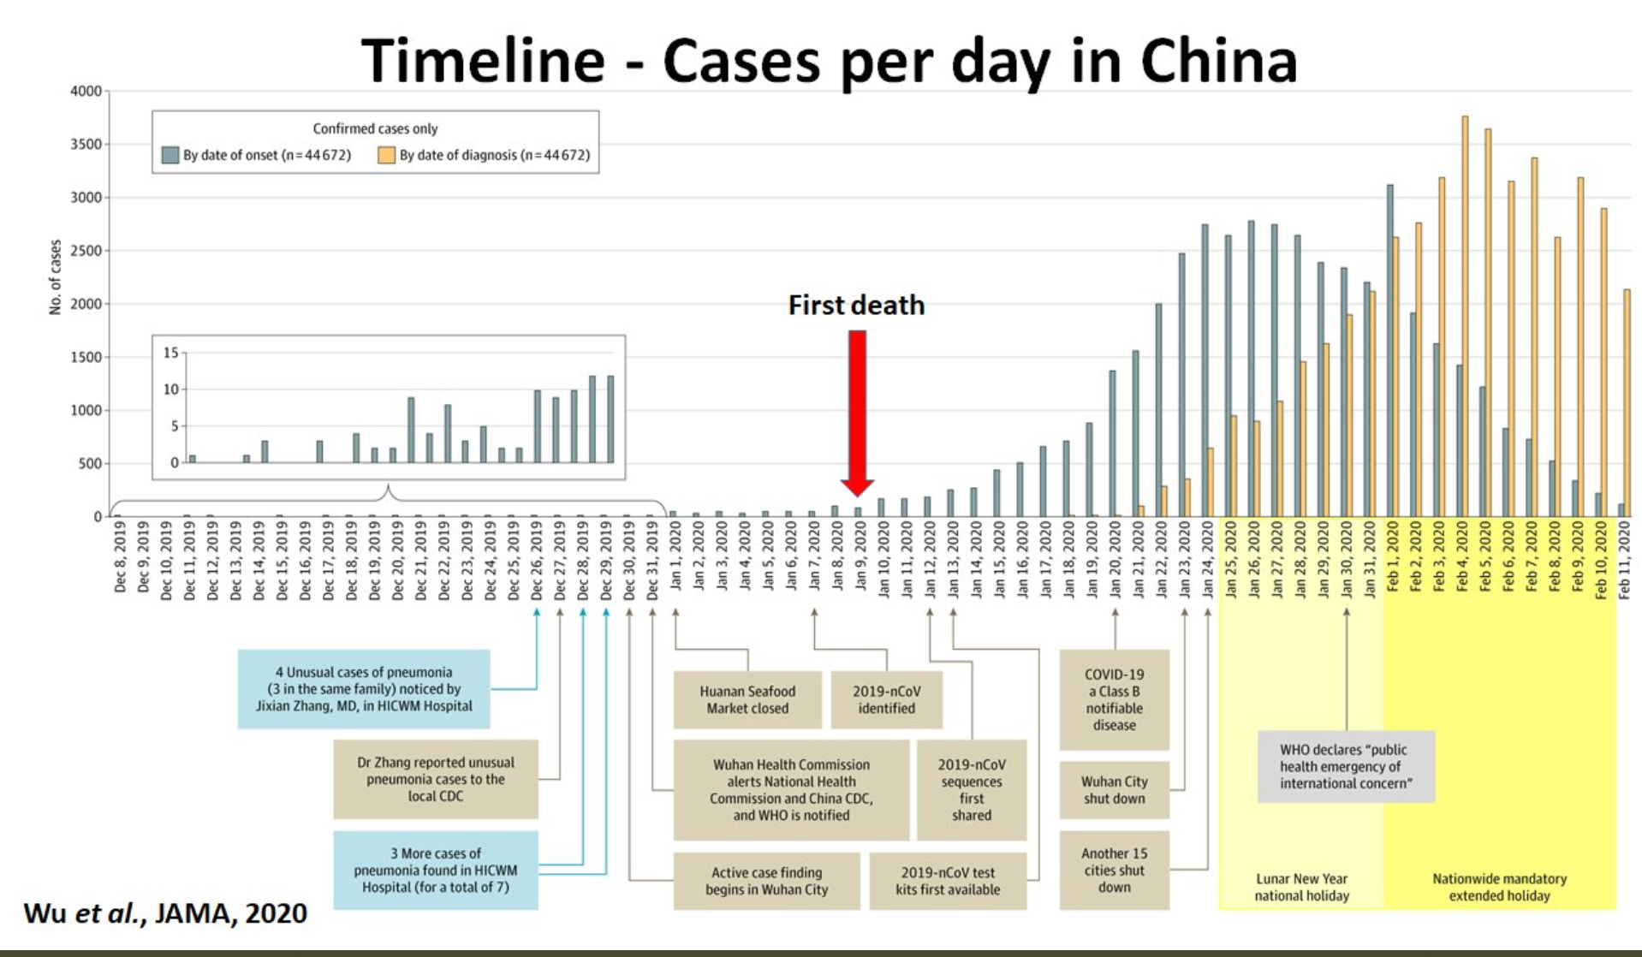
What We Think Happened in Wuhan
China beat it quickly & relatively easily!
We think
Shut down Wuhan when 200 cases per day
That seems to have been a good decision

Slide 58
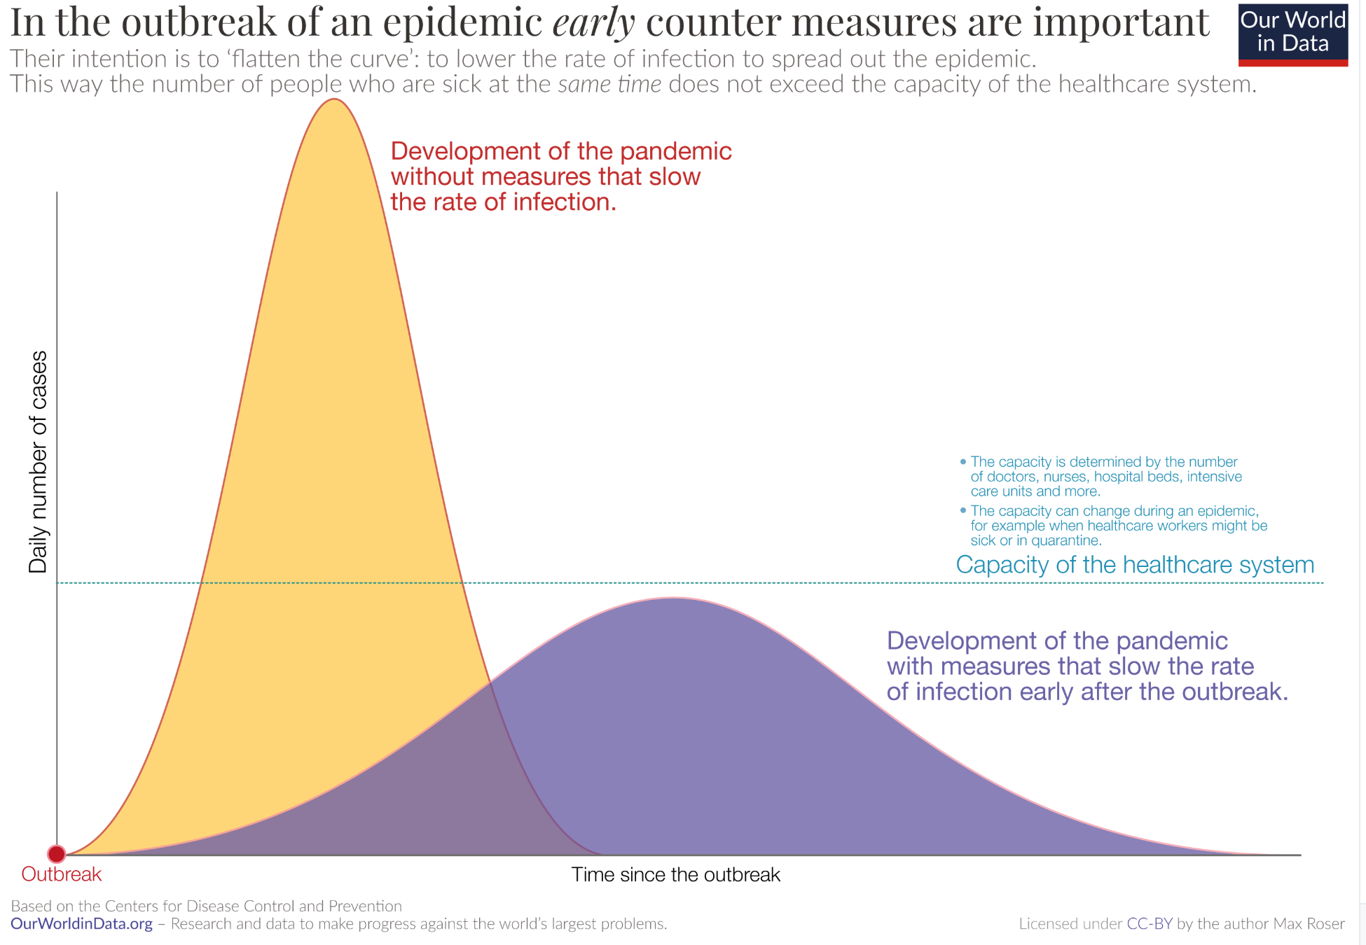
The Goal
When Is It Appropriate to Move on This?
Immediate social distancing…
Self-isolate if you have a cough and a fever…
Hope that warmer temperatures will do to this what they did to SARS…
Otherwise, when do you want to start spreading out transmission. It seems that early is as good as later, so do it early…
I have no good intuition on why you want to move early
Plus your moving early will be wasted if you get reinfected
Plus the sparks you throw off making others’ lives more difficult

Slide 59
References
Financial Times (2020): Coronavirus Tracked: The Latest Figures as the Pandemic Spreads <https://www.ft.com/coronavirus-latest>
Nick Rowe (2020): Relative Supply Shocks, Unobtainium, Walras' Law, and the Coronavirus <https://worthwhile.typepad.com/worthwhile_canadian_initi/2020/03/relative-supply-shocks-unobtainium-walras-law-and-the-coronavirus.html>
Jim Stock (2020): Coronavirus Data Gaps and the Policy Response <https://drive.google.com/file/d/12MV466ZZy5xHir4xdPhoTrL1oO8CbZU-/view>

Slide 60
MOAR Coronavirus!
What I am watching:
Max Roser & Hannah Ritchie: Coronavirus Disease (COVID-19) <https://ourworldindata.org/coronavirus>…
Worldometer: Coronavirus Update (Live) <https://www.worldometers.info/coronavirus/>: ‘125,599 Cases and 4,605 Deaths from COVID-19 Virus Outbreak…
FT Coronavirus Tracker <https://www.ft.com/content/a26fbf7e-48f8-11ea-aeb3-955839e06441>
Josh Marshall’s COVID Twitter List <https://twitter.com/i/lists/1233998285779632128>
NEJM Group: Updates on the Covid-19 Pandemic <http://m.n.nejm.org/nl/jsp/m.jsp?c=%40kxNtXckRDOq8oG0jJvAXsIzN4mPECIPhltxoTSdTU9k%3D&cid=DM89089_NEJM_COVID-19_Newsletter&bid=173498255>: 'From the New England Journal of Medicine, NEJM Journal Watch, NEJM Catalyst, and other trusted sources...

Slide 61
Catch Our Breath…
Ask a couple of questions?
Make a couple of comments?
Any more readings to recommend?
<https://www.icloud.com/keynote/0YKEi7HeOrVGvKYtt9FEqH7nA>

Slide 62
Coronavirus! (March 16)
With 31 deaths in the U.S. as of March 11, a 1% death rate, and up to 4 weeks between infection and death, that means that as of Feb 12 there were 3100 coronavirus cases in the United States.
With 87 deaths in the U.S. as of Mar 16, a 1% death rate, and up to 4 weeks between infection and death, that means that as of Feb 17 there were 8700 coronavirus cases in the United States
If it is doubling every seven days, then now about 150,000 people have and in the next week about 150,000 more people in the U.S. will catch coronavirus—which means 1/2200, currently 3500 of the 7.6 million inhabitants of San Francisco Bay. Touch a hard surface that any of those 3500 has touched in the last 48 hours, and the virus has a chance to jump to you…
These numbers could be five times too big. These numbers are probably not five times too small unless the thing is a lot less deadly, and there are a lot of asymptomatic cases…
What is wrong with this analysis?

Slide 63
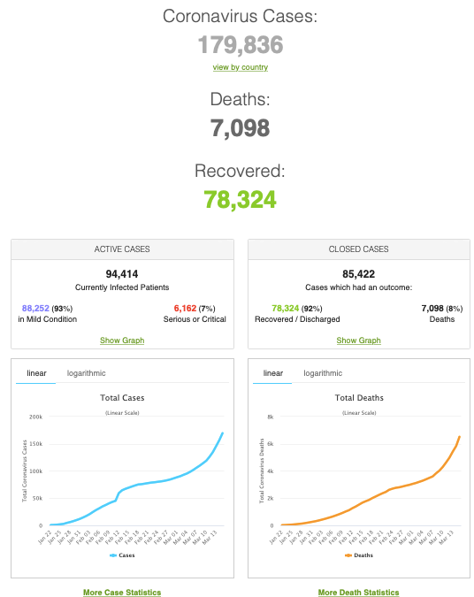
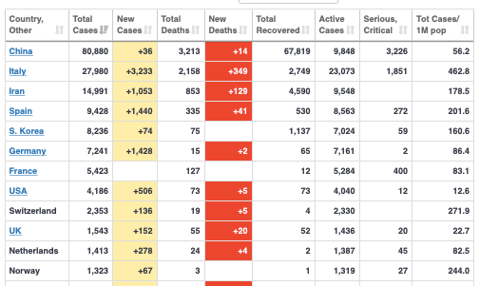
MOAR Coronavirus!
As of March 21: Things are not moving in the right direction:
What is the R0?
How can the R0 be changed?
How will the R0 change?
What is the asymptote share of the population?
What is the mortality rate?

Slide 64
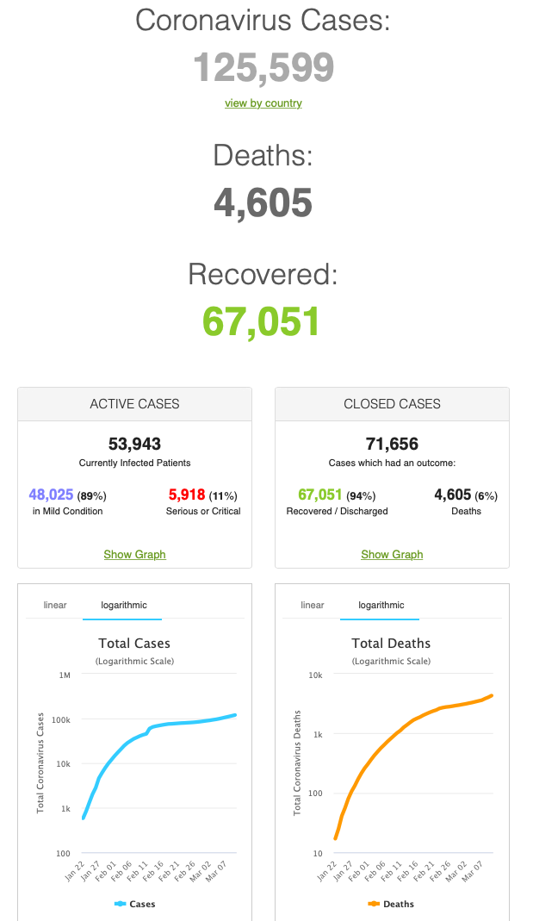
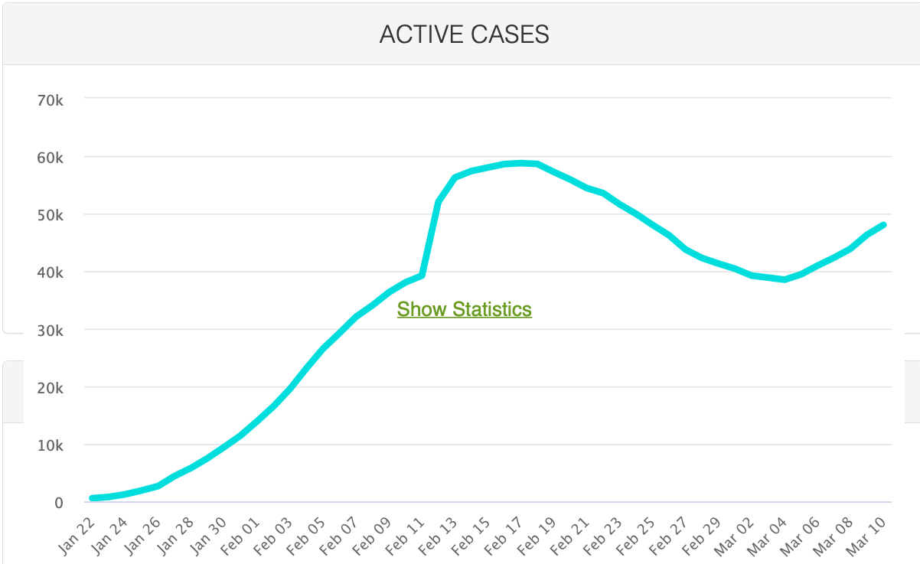
MOAR Coronavirus!
As of March 10: Things are not moving in the right direction:
What is the R0?
How can the R0 be changed?
How will the R0 change?
What is the asymptote share of the population?
What is the mortality rate?

Slide 65
Notes

